Slide 1

CSA0407 - Operating systems
A Real-time embedded system used in
traffic signal control.
Faculty Name: Dr.J.Vasavi
Name : Ch.Akhil
Reg no:192525250

Slide 2


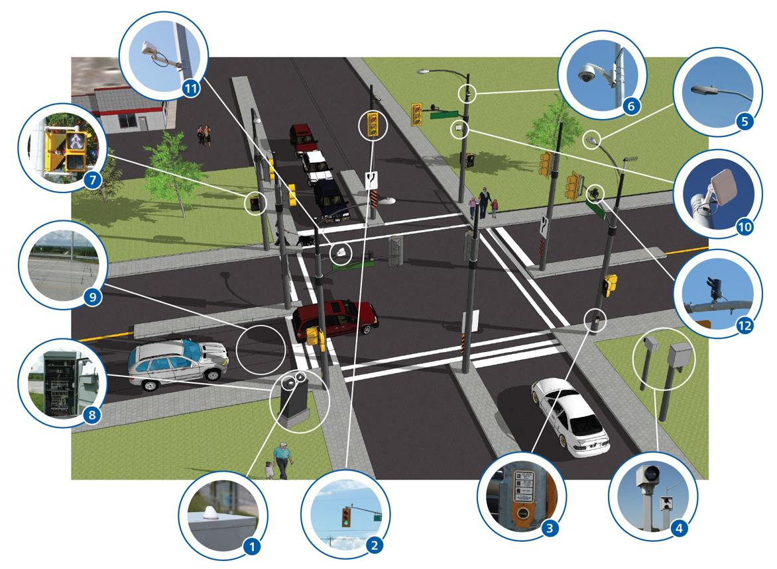
Introduction: Traffic Signal Control
Real-Time Embedded System for Traffic Signal Control
Traffic signal control is a real-time embedded system.
It controls Red, Yellow and Green lights.
Sensors detect vehicles and traffic conditions.
The system must respond within a fixed time.
Accurate timing is important for safety and smooth traffic flow.

Slide 3
Type of OS: RTOS
Real-Time Operating System (RTOS)
RTOS is the most suitable OS for traffic signal control.
Provides predictable response time.
Provides accurate signal timing.
Supports priority-based scheduling.
Handles sensor interrupts quickly.
Provides high reliability and low latency.
Examples: FreeRTOS, Zephyr, QNX, VxWorks

Slide 4
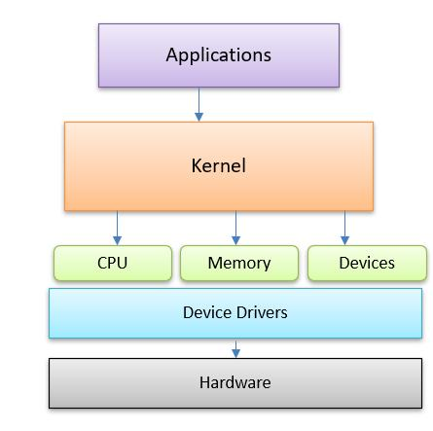
OS Structure and Components
Main Components
Kernel – manages system resources.
Scheduler – selects which task runs.
Device Drivers – communicate with sensors and lights.
Timers – maintain signal timing.
Interrupt Handler – responds quickly to external events.

Slide 5
System Calls for Process Control & Timing
Process Control
xTaskCreate() → Creates a task.
vTaskDelay() → Delays/suspends a task.
vTaskDelete() → Deletes a task.
Task Priority → Gives importance to critical tasks.
Timing
Delay → Provides a fixed waiting period.
Software Timer → Performs an action after a specified time.
Semaphore/Notification → Synchronizes tasks.
Example:
Green 30 sec → Yellow 5 sec → Red → Next signal

Slide 6

Conclusion
RTOS is ideal for traffic signal control because of its predictable response.
The OS kernel manages tasks, scheduling, interrupts and timers.
System calls control task creation, deletion and delays.
Timers ensure accurate Red, Yellow and Green durations.
The system provides safe, reliable and efficient traffic management.
Final Statement
“RTOS ensures that every traffic signal changes at the correct time, improving traffic safety and efficiency.”

Slide 7


